Slide 1
Business Case-Dynamic template creation, multilingual support, smart personalization, and automated email delivery using Azure Agentic AI and ML.NET
KPIs Impacted
WHY
BUSINESS CASE
Business Challenges
Use Case Description
Operational Efficiency
Customer Engagement & Experience
Cost Optimization Quality
Accuracy & Compliance Intelligence
Continuous Improvement
Manual template creation
Poor personalization
Language barriers
Template sprawl
Data errors
Compliance risk
Scalability issues
No learning
AI‑Driven Adaptive Email Automation Platform
This use case describes an intelligent, scalable email automation platform that enables organizations to create, personalize, translate, preview, and deliver emails dynamically using Azure Agentic AI and ML.NET. The solution eliminates manual email template creation and static workflows by leveraging AI agents to generate and manage HTML email templates, intelligently populate placeholders, support multilingual communication, and automate secure email delivery at scale.
Business Impact
This solution transforms enterprise email communication into an AI‑driven, scalable, and self‑optimizing capability—accelerating time‑to‑market, increasing customer engagement through intelligent personalization and multilingual delivery, and reducing operational cost and risk through end‑to‑end automation.
Stakeholders
Functional Solution
Technical Solution
An AI‑driven email automation solution that dynamically generates, personalizes, translates, previews, and delivers emails at scale using Azure Agentic AI and ML.NET, with built‑in learning and governance.
Stakeholders for this solution span business leadership, customer‑facing teams, IT and AI engineering, and governance functions, ensuring strong sponsorship, effective adoption, secure operations, and measurable business value.
A cloud‑native, Azure‑based solution using Agentic AI (Azure OpenAI), ML.NET, serverless orchestration, and Azure Communication Services to dynamically generate, personalize, translate, validate, and deliver HTML emails at scale with continuous learning and monitoring

Slide 2
Technical Solution and List of Work flow
A cloud native, AI orchestrated workflow that dynamically generates, personalizes, translates,
validates, and delivers emails while continuously learning and optimizing outcomes.
User initiates an email request via UI, API, or integrated system
API Management routes the request to Azure Functions
Agentic AI analyzes intent and decides to generate, fetch, or modify a template
Template is generated or retrieved and placeholders are defined
ML.NET applies personalization recommendations (tone, layout, CTA)
HTML template is auto‑populated with runtime data
Content is translated if a non‑default language is requested
Attachments and BCCs are validated and added
User previews and optionally edits the email
AI performs final content and validation checks
Email is sent using Azure Communication Services
Delivery, engagement, and usage data are logged
ML models and AI agents learn from feedback to improve future requests
technologies
• Azure App Service / Azure Static Web Apps
• React / Angular / Blazor
• Monaco Editor / TinyMCE
• Azure API Management
• Azure Logic Apps
• Azure Service Bus (optional, event driven processing)
• Azure AI Studio (Agentic Workflows)
• Azure OpenAI (GPT 4 / GPT 4o)
• Azure Functions (HTML sanitization & validation)
• Azure Blob Storage
• Azure Cosmos DB / Azure SQL Database
• Azure DevOps / GitHub (optional version control)
• ML.NET
• Azure Machine Learning (optional for lifecycle management)
• Azure Translator (Cognitive Services)
• Azure OpenAI (context aware translation refinement)
• Azure Communication Services (Email)
• SendGrid on Azure (optional alternative)
• SMTP Gateway (legacy fallback)
• Azure Application Insights
• Azure Monitor
• Azure Log Analytics

Slide 3
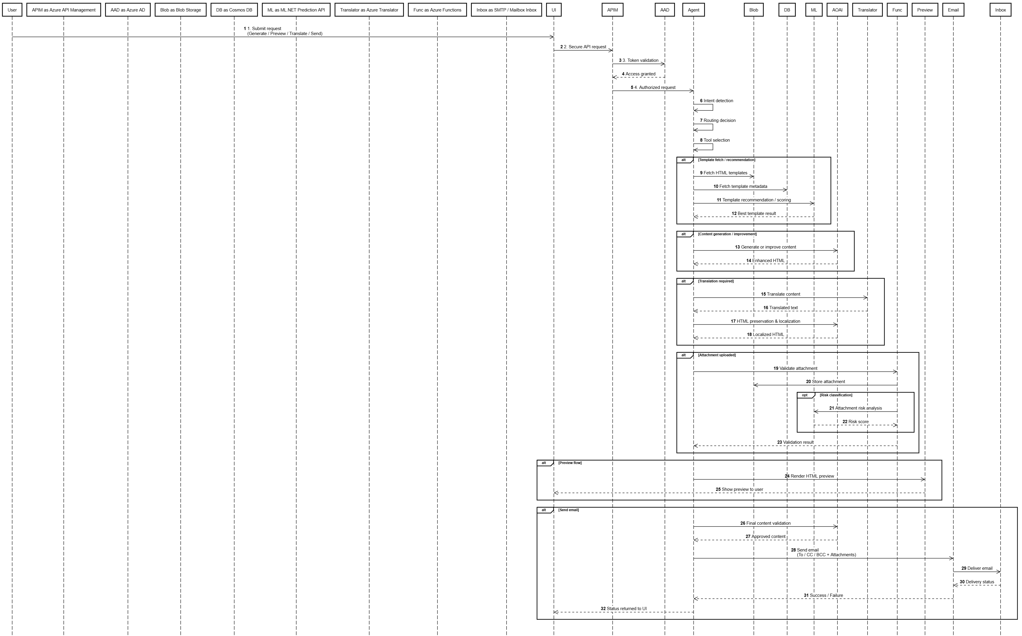
Sequential Diagram - Architecture

